Slide 1
Your Online Professional Identity
November 2019

Slide 2
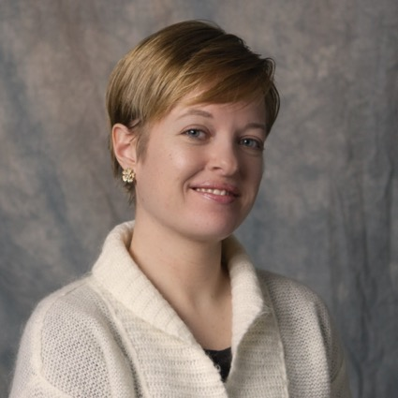
Introductions
Peg Burnette
phburn@Illinois.edu
Associate Professor and Medicine & Biomedical Librarian
Erin Kerby
ekerb@Illinois.edu
Associate Professor and Veterinary Medicine Librarian

Slide 3
Today’s Session
What is an online professional/scholarly identity & why should you care?
Tools for Academics and Professionals
Institutions and Research Information Management (RIM)
Social media and your professional identity
Wrap-up & Questions

Slide 4
Be yourself; everyone else is already taken
Oscar Wilde https://www.theguardian.com/childrens-books-site/2014/aug/26/top-10-quotes-on-identity-for-teenagers-george-r-r-martin

Slide 5
What is an online professional/scholarly identity?

Slide 6
Professional Personas
Formal Self …showcase your professional life/accomplishments through static objects such as CV, publications, presentations, etc.
Networked Self …share ideas and network within the professional/institutional/academic setting
Comprehensive Self …composite of professional and personal/social life
Uncontrollable Self …what is out there about you that you do not currently control
Adapted From Lisa Hinchliffe’s “Create and Manage and Online Scholarly Presence”
https://guides.library.illinois.edu/c.php?g=348192&p=2346605

Slide 7
What personas do you have?
Know what is “out there” about you
Fix what you can control
Mitigate what you can’t control

Slide 8
Why have an online identity?
Visibility and reputation
Potential employers/employees
Collaboration and networking
Engagement and sharing
Representation of accomplishments
Name disambiguation
Track citations
Show evidence of impact
If you don’t take control, “something else” will.

Slide 9
Best Practices
Be guided by your present and where you want to go
Keep your online persona up to date
Standardize your name and affiliation
Be Consistent across tools (name, title, keywords, professional photo)
Share publications, presentations and professional accomplishments
If you deposit publications and presentations into a repository you can provide links on other profile sites
Become familiar with privacy and confidentiality policies

Slide 10
Online Identity Tools
Individuals
Academia.edu
Research Gate
Google Scholar
Scopus Author ID
Publons
ORCID*
Institutions
PURE
VIVO
PLUMX
ORCID*
Either/Or
Linkedin
Twitter
Blogs

Slide 11
Perhaps the rare and simple pleasure of being seen for what one is compensates for the misery of being it.
MARGARET DRABBLE, A Summer Bird-Cage http://notable-quotes.com/i/identity_quotes_iv.html

Slide 12
Tools for academics & Professionals

Slide 13
BENEFIT | INDIVIDUAL | INSTITUTION
Showcase research and scholarship |  | 
Share publications, presentations and more | 
Serve as a record of professional activities | 
Serve as a record of publications |  | 
Demonstrate impact |  | 
Provides opportunities for networking and collaboration |  | 
Notes:
Peg

Slide 14
Academia.edu
1,000,000+ academics & researcher
Free Account
Basic Analytics – for papers that are uploaded
Basic profile
Upload papers
Email notifications – default = all
Sessions - Share drafts for feedback
Contacts – Google/Facebook/Twitter/Yahoo
*Premium Account
Readers
Mentions
Expanded analytics
Advanced search
Search Alerts
Profile Visitors
Personal website
Grants

Slide 15
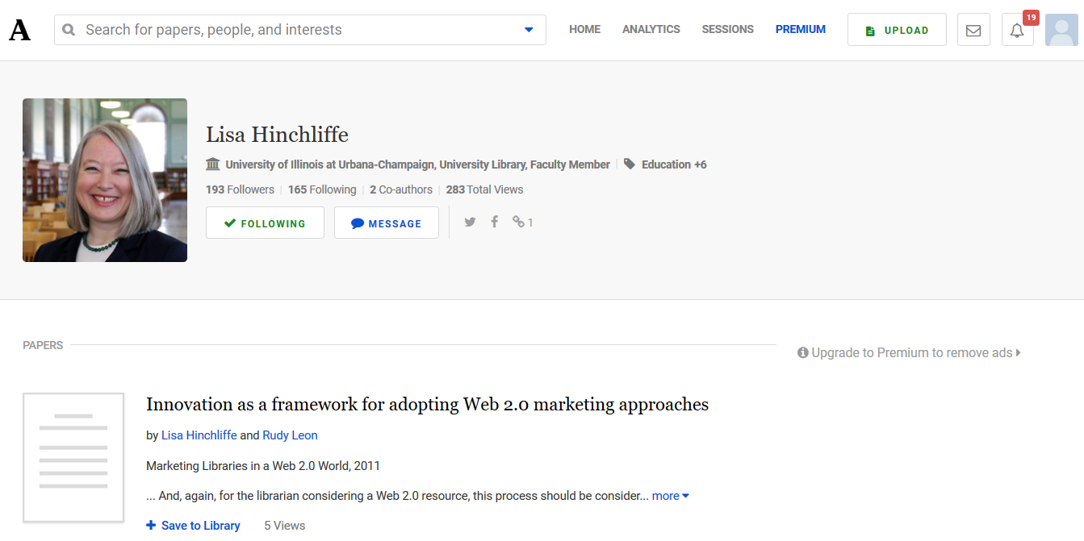

Slide 16
Research Gate
“…is the professional network for scientists and researchers…to share, discover, and discuss research.
Over 15 million users
Free to join (institutional email required)
Share publications and publish data
Recruitment - Research-focused job board
Messages - Connect and collaborate with colleagues, peers and others
Account Info
Overview – research area, etc.
Research - upload publications
Info – skills/expertise
Scores - RG Score, H-index
Stats - reads, citations, etc.

Slide 17
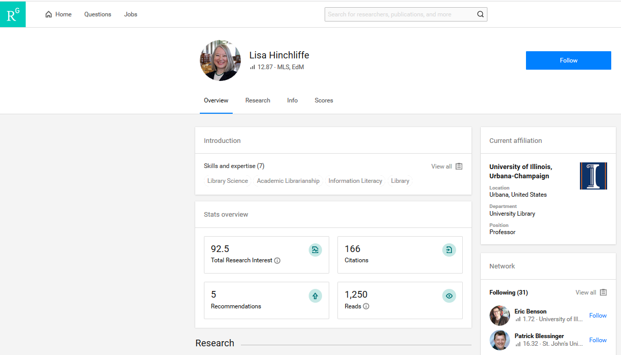

Slide 18
Google Scholar
If you have publications in Google Scholar you can create a profile
Your profile can be public or private
Good for broad dissemination of scholarly works
Provides publication and citation metrics for authors
Track your article citations
See who is citing you
View your h-index
For your Google Scholar account:
Include affiliation
Confirm publications
Add publications manually as needed
Add co-authors
Create alerts to track publications

Slide 19
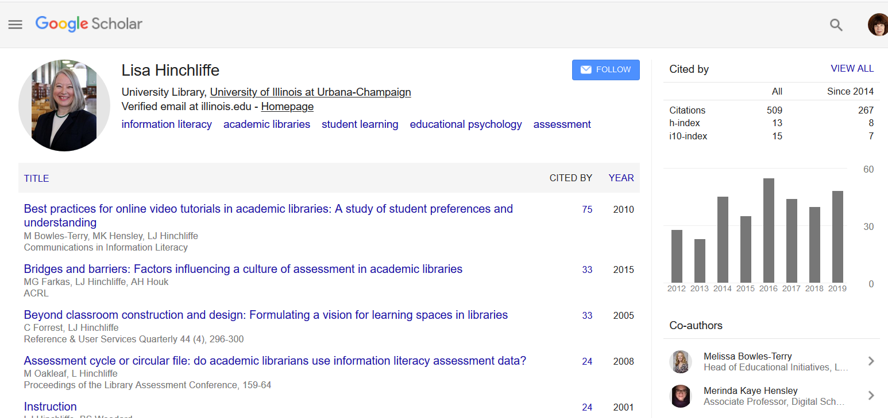

Slide 20
Scopus’ Author ID
Scopus IDs are created automatically
Merge multiple author IDs under a single record
Changes to your profile are reviewed before they are active
We have received your request!
Request ID: 1993648
*Note if your request requires manual review, it can take up to one week to process.
Citation metrics

Slide 21
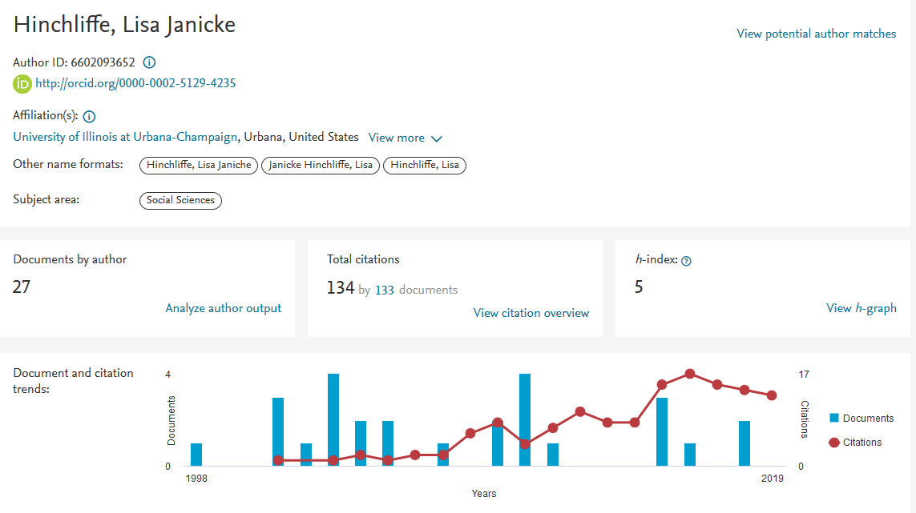

Slide 22
publons
Publons was first built as a place to help researchers get recognition for their often hidden peer review contributions.
Publons was recently integrated with Web of Science and ResearcherID to provide an integrated platform
Publications can be imported from Web of Science, ORCID, EndNote, or Mendeley
Citation metrics
Tracks peer review and journal editing history

Slide 23
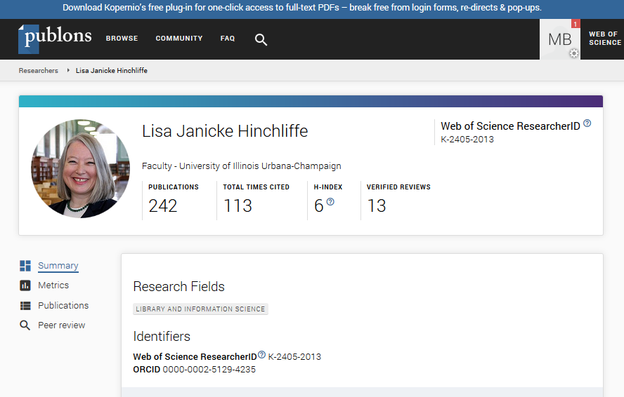

Slide 24
Well, I try my best To be just like I am But everybody wants you To be just like them
BOB DYLAN, "Maggie's Farm http://notable-quotes.com/i/identity_quotes_ii.html

Slide 25
assorted identity Tools

Slide 26
Orcid individuals and institutions
Not for profit registry of unique and persistant digital identifiers for researchers
Links to research output
Imports from partner organizations (Web of Science, Scopus)
Add other external identifiers (ResearcherID, Scopus Author ID)
Link to other systems or profiles (Google Scholar, LinkedIn)
You choose what information to make public

Slide 27
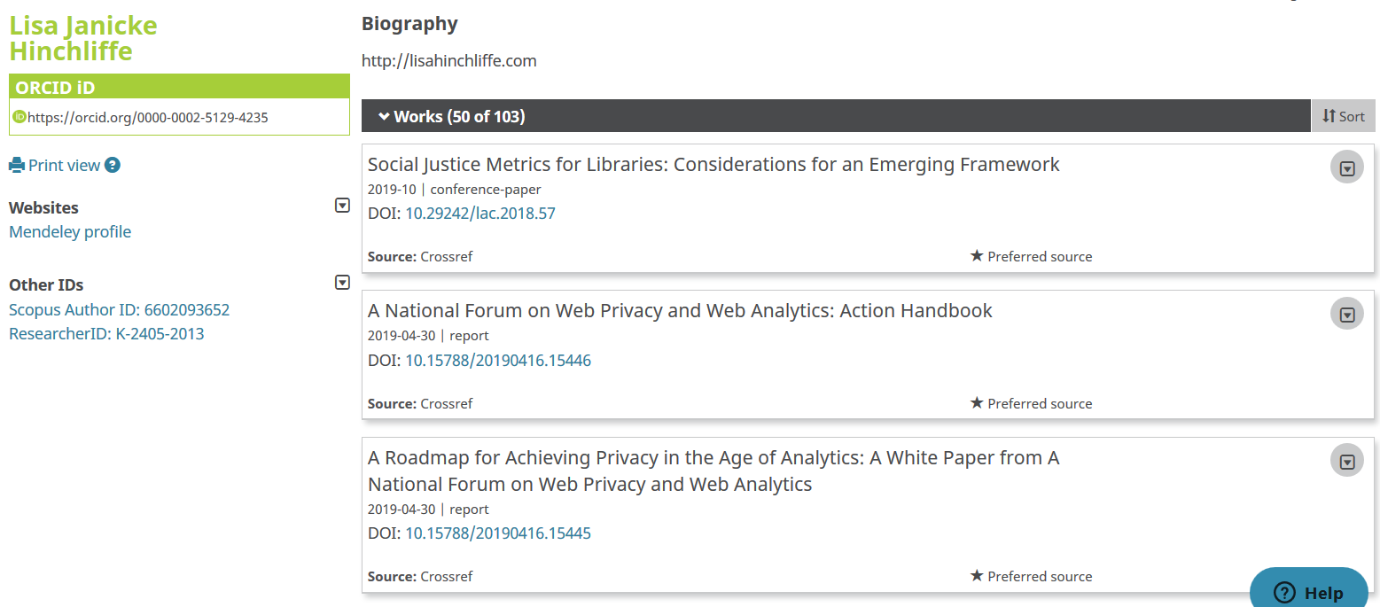

Slide 28
Mendeley
“…is a free reference manager and academic social network that can help organize your research, collaborate, and discover the latest research”
6 million researchers
Free to join
Create online account or download
Overview
Impact
Publications
Network
Collaborate with others
Account
Feed – blog posts
Library – saved citations
Suggest – articles and people
Groups
Datasets
Careers
Funding Opportunities

Slide 29
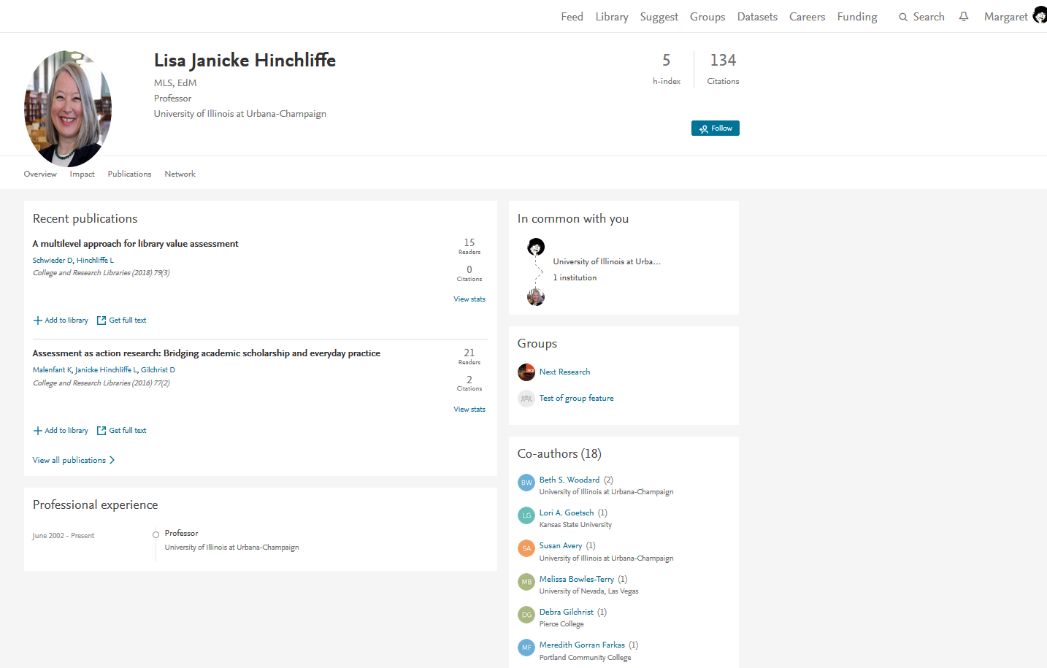

Slide 30
I don't need to worry about identity theft because no one wants to be me.
Jay London https://www.brainyquote.com/authors/jay_london

Slide 31
Institutional Research Information Management (RIM)

Slide 32
What is a rim?
Online system used by institutions to track and manage research project inputs and outputs
Scholarship promotion
Networking
Data management
Grants administration
Researcher information
Reference and citation management
Name disambiguation

Slide 33
Libraries support RIMS
Collection and curation of metadata for campus research activity
Publication management & tracking
Links to institutional repositories
Training
Funding
Research support
Data management
Research analytics
Administrative roles

Slide 34
Pure (Elsevier)
Commercial
Emphasis on publications and grant funding
Pulls in publications from Scopus
Fingerprint metadata provides keywords

Slide 35
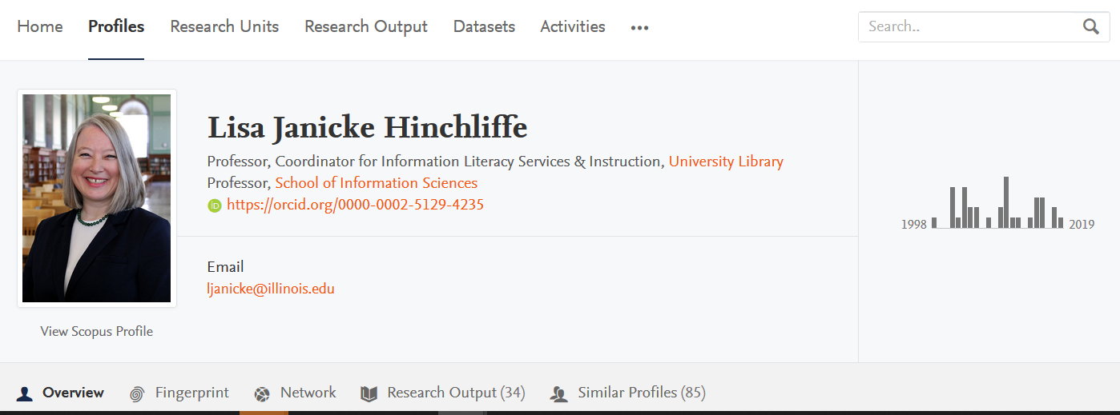

Slide 36
Vivo
Open Source
Open Community
Open Data
More emphasis on networking and facilitating collaboration

Slide 37
Plum Analytics
Plum Analytics
Fee-based – institutional subscription
Citations – articles, patents, clinical citations, policy citations
Usage – who is readings/citing publications, etc.
Captures – saves such as bookmarks, code forks, favorites, readers, watchers
Mentions – news articles, blog posts about research
Social media – measures “buzz” based on retweets, likes, comments, shares, etc.

Slide 38
The more identities a man has, the more they express the person they conceal.
JOHN LE CARRÉ, Tinker http://notable-quotes.com/i/identity_quotes.html

Slide 39
Social Media

Slide 40
Linkedin
More than 200,000,000 users
Typically used for self-promotion and employment search
Free or fee-based premium accounts
Premium accounts offer extra features such as InMail messages, advanced search features, and access to data on companies and people
Connect with colleagues
Allows you to highlight and post about your academic work

Slide 41
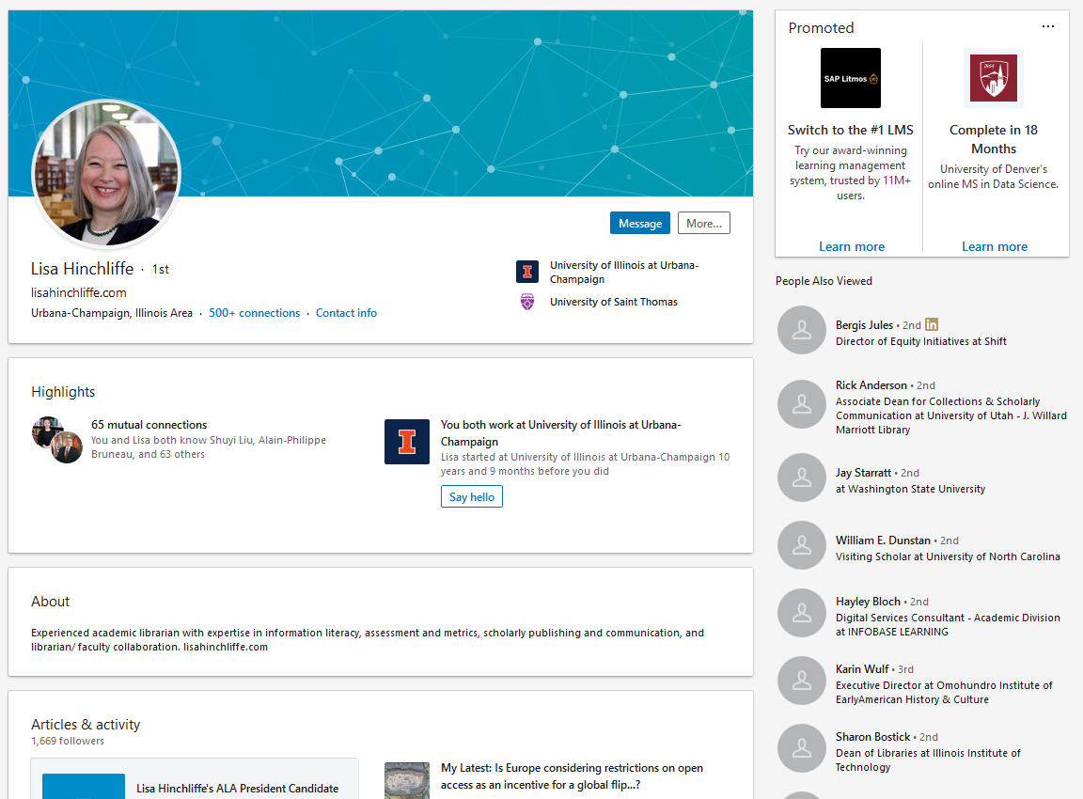

Slide 42
Twitter
Free account
Create personal and/or unit/organizational account
Create a user handle that easily identifies who you are
Tweet about new developments with a project or research
Use Hashtags to promote your posts
Twitter Analytics

Slide 43
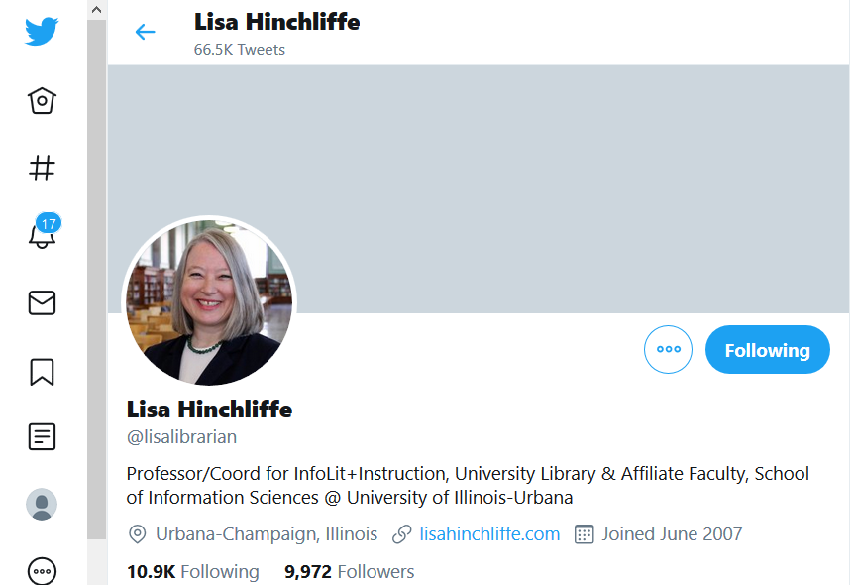

Slide 44
instagram
Free account
Create personal and/or unit/organizational account
Use to share photos and videos across multiple platforms
Similar guidelines as Twitter
Generate an audience by using graphs, photos, and short videos

Slide 45
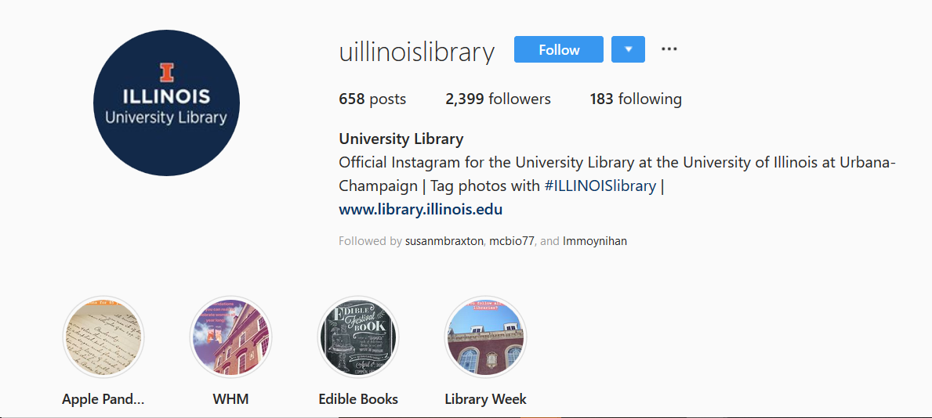

Slide 46
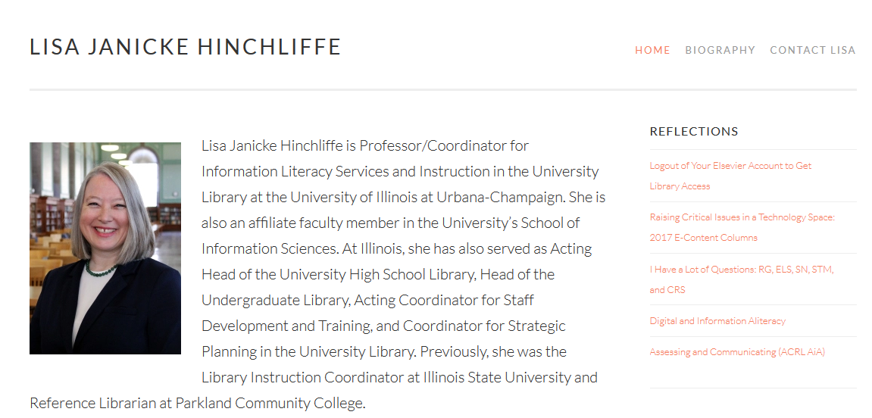
Lisahinchliffe.com

Slide 47
Blogs
Free or fee-based account
Wordpress, Blogger, TypePad
Can a broader impact
Use to generate interest in your work
Posts can be shared on social media
Publishers like to see that your work has followers
Ability to share more details of your work

Slide 48
One account or two?
Use one account for your professional persona – this could be a unit or departmental account
Use a separate account for your personal life
Be sure you are logged into the right account when you post
Online tools like TweetDeck will allow you to post form multiple accounts, but be careful what you share

Slide 49
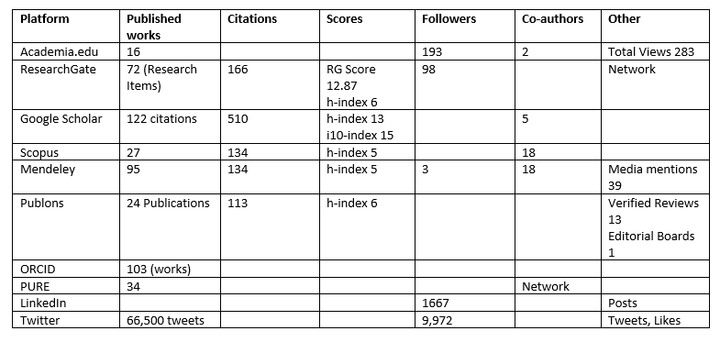

Slide 50
Caveats
Academia.edu is commercial, for profit
Scopus ID is owned by Elsevier
Pure is owned by Elsevier
Publons is tied to Clarivate
Be vigilant about what you get yourself into
Read the fine print regarding information privacy and sharing

Slide 51
In summary
Be strategic about profiles you choose to use
Less is more when it comes to your professional online presence
These are a reflection of your professionalism – be professional
Keep your profiles up to date
Be consistent – use one full version of your name
Cross-link profiles as much as possible
Track your impact

Slide 52
Going Forward
Make a plan for your online identity and keep things current
Support users
Creating guide or toolkit for curating one’s professional identity
Plan seminars or hands-on workshops on identity tools and other online presence topics
Raise awareness about online identity and impact to your organization’s administration

Slide 53
Questions or comments?
Thank You!

